Slide 1
Fuzzy C-means Clustering
Dr. Bernard Chen
University of Central Arkansas

Slide 2
Reasoning with Fuzzy Sets
There are two assumptions that are essential for the use of formal set theory:
  For any element and a set belonging to some universe, the element is either a member of the set or else it is a member of the complement of that set
  An element cannot belong to both a set and also to its complement

Slide 3
Reasoning with Fuzzy Sets
Both these assumptions are violated in Lotif Zadeh.s fuzzy set theory
Zadeh.s main contention (1983) is that, although probability theory is appropriate for measuring randomness of information, it is inappropriate for measuring the meaning of the information
Zadeh proposes possibility theory as a measure of vagueness, just like probability theory measures randomness

Slide 4
Reasoning with Fuzzy Sets
The notation of fuzzy set can be describes as follows:
let S be a set and s a member of that set, A fuzzy subset F of S is defined by a membership function mF(s) that measures the “degree” to which s belongs to F

Slide 5
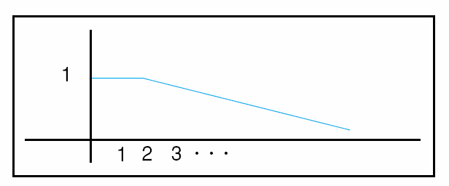
Reasoning with Fuzzy Sets
For example:
S to be the set of positive integers and F to be the fuzzy subset of S called small integers
Now, various integer values can have a “possibility” distribution defining their “fuzzy membership” in the set of small integers: mF(1)=1.0, mF(3)=0.9, mF(50)=0.001

Slide 6
Reasoning with Fuzzy Sets
For the fuzzy set representation of the set of small integers, in previous figure, each integer belongs to this set with an associated confidence measure.
In the traditional logic of “crisp” set, the confidence of an element being in a set must be either 1 or 0

Slide 7
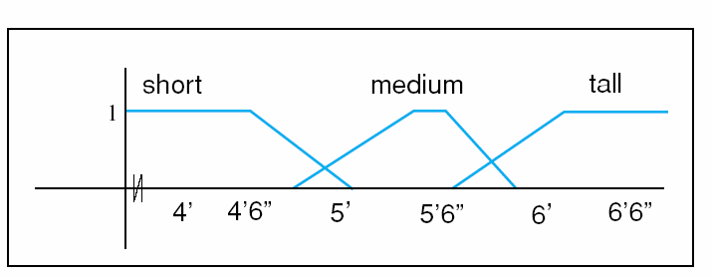
Reasoning with Fuzzy Sets
This figure offers a set membership function for the concept of short, medium, and tall male humans.
Note that any one person can belong to more than one set
For example, a 5.9” male belongs to both the set of medium as well as to the set of tall males

Slide 8
Fuzzy C-means Clustering
Fuzzy c-means (FCM) is a method of clustering which allows one piece of data to belong to two or more clusters.
This method (developed by Dunn in 1973 and improved by Bezdek in 1981) is frequently used in pattern recognition.

Slide 9
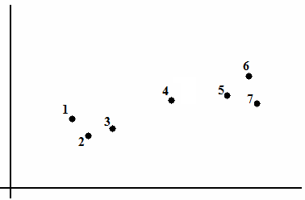
Fuzzy C-means Clustering

Slide 10
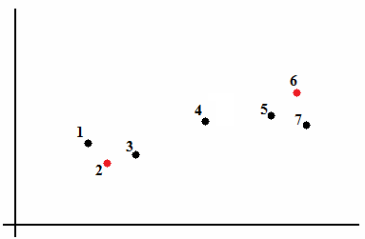
Fuzzy C-means Clustering

Slide 11
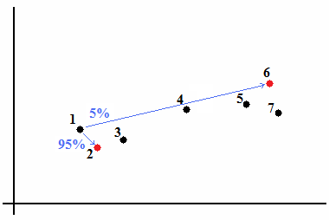
Fuzzy C-means Clustering

Slide 12
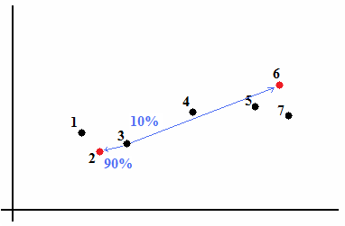
Fuzzy C-means Clustering

Slide 13
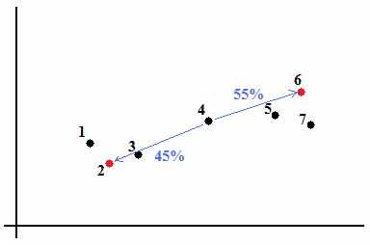
Fuzzy C-means Clustering

Slide 14
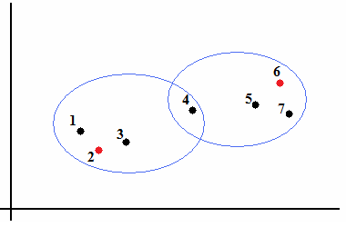
Fuzzy C-means Clustering

Slide 15
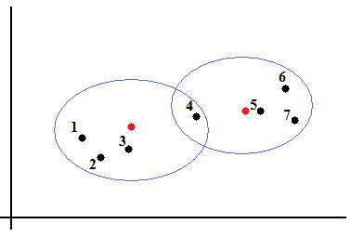
Fuzzy C-means Clustering

Slide 16
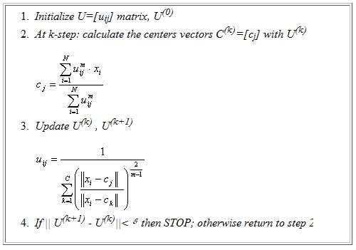
Fuzzy C-means Clustering http://home.dei.polimi.it/matteucc/Clustering/tutorial_html/cmeans.html

Slide 17
Compare with
K-Means Clustering Method
Given k, the k-means algorithm is implemented in four steps:
  Partition objects into k nonempty subsets
  Compute seed points as the centroids of the clusters of the current partition (the centroid is the center, i.e., mean point, of the cluster)
  Assign each object to the cluster with the nearest seed point
  Go back to Step 2, stop when no more new assignment

Slide 18
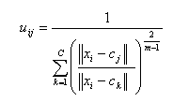

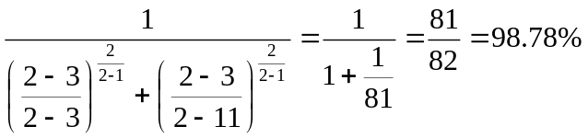
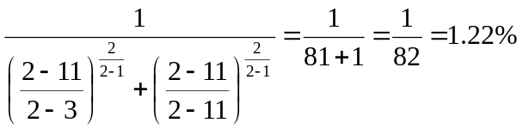
Fuzzy C-means Clustering
For example: we have initial centroid 3 & 11
(with m=2)
For node 2 (1st element):
U11 =
The membership of first node to first cluster
U12 =
The membership of first node to second cluster

Slide 19
Fuzzy C-means Clustering
For example: we have initial centroid 3 & 11
(with m=2)
For node 3 (2nd element):
U21 = 100%
The membership of second node to first cluster
U22 = 0%
The membership of second node to second cluster

Slide 20
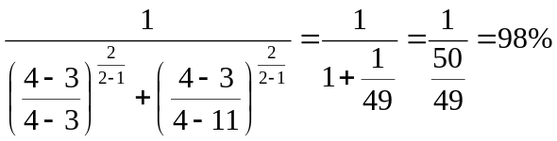
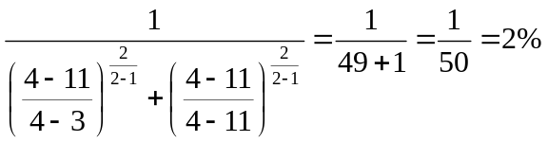
Fuzzy C-means Clustering
For example: we have initial centroid 3 & 11
(with m=2)
For node 4 (3rd element):
U31 =
The membership of first node to first cluster
U32 =
The membership of first node to second cluster

Slide 21
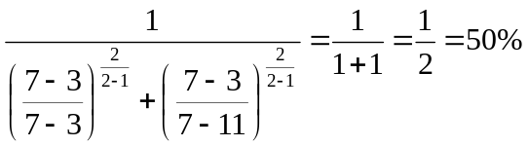
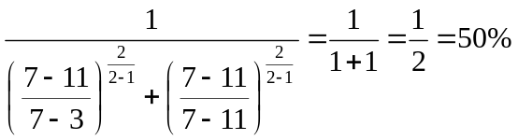
Fuzzy C-means Clustering
For example: we have initial centroid 3 & 11
(with m=2)
For node 7 (4th element):
U41 =
The membership of fourth node to first cluster
U42 =
The membership of fourth node to second cluster

Slide 22
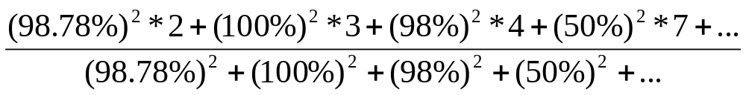

Fuzzy C-means Clustering
C1=

